Slide 1
Classification of Computers & Applications of Computers

Slide 2
Classification
Personal Computers
Laptops
Network Computers
Minicomputers
Microcomputers
PDAs
Workstations
Servers
Mainframes
Supercomputers

Slide 3
Personal Computers
Used at home
Used in Educational Institutions and Organizations as nodes
Can perform typical activities like documentation, playing games etc.

Slide 4
Laptops
Same as PCs in functionality
More Compact, Portable
Less Power requirement, operated on battery/s
Less capacity compared to PCs
Maintenance and actually are costlier compared to PCs
Theft prone

Slide 5
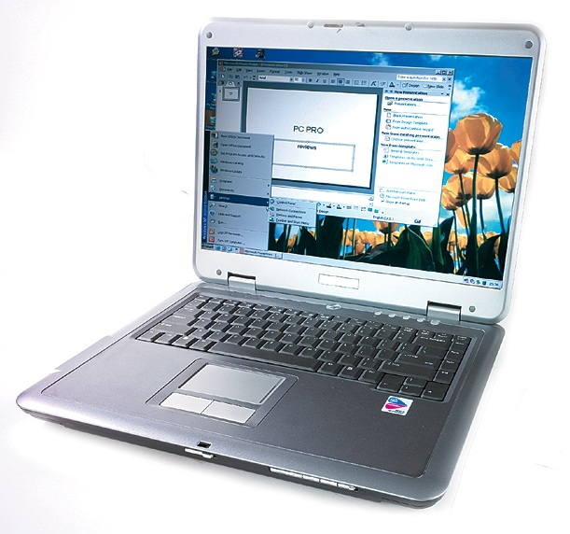

Slide 6
Network Computers
Collection of PCs
Additional Network Interface Card
Can share the information, work from anywhere environment
LAN – WAN – MAN – Internet
Uniting the World

Slide 7
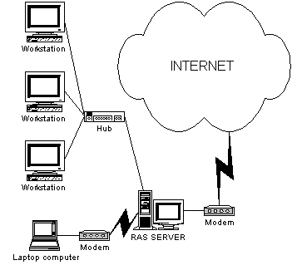

Slide 8
Microcomputers
Microcomputer is also called Personal Computer
Much slower and cannot store huge information

Slide 9
Minicomputers
Minicomputers are in between mainframes and Microcomputers. They are also called midrange computers
It is a class of multiuser computer, much smaller than mainframe computer.
Possess most of the features found on mainframe computer, but on a more limited scale.
Ex: Medium and small business typically use these computers.

Slide 10
PDA – Personal Digital Assistant
Smaller than laptops (can be called Palmtops)
Used to store information used frequently wherever you go

Slide 11
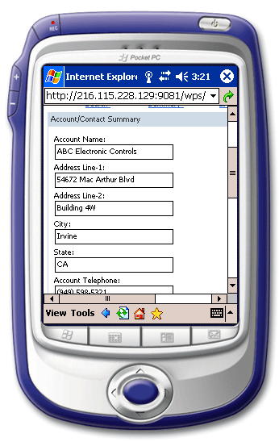
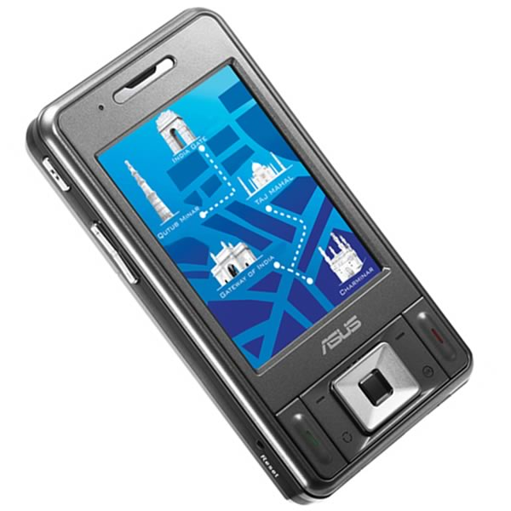

Slide 12
Workstations
They are similar to PCs but with more memory and a high speed processor
They are used in architectural design, video editing, animations etc.

Slide 13
Servers
A server is one for which many PCs are connected.
It has large capacity secondary storage and more memory
They provide special types of service.
They avoid duplicate installation of applications and all users will access to a common copy of the program

Slide 14
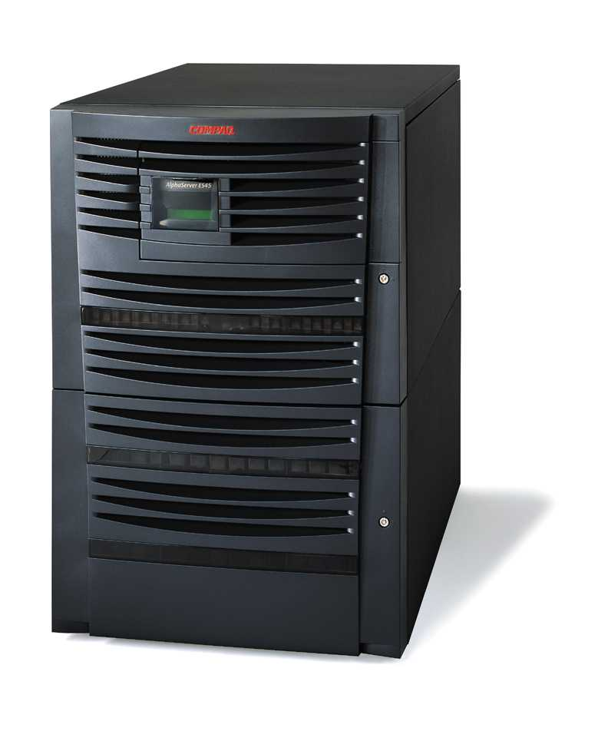
Server

Slide 15
Mainframes
Large computers both in terms of physical size as well as computations
They support huge numbers of users
Basically used to store and process huge amount of data
Not all organizations can offer one mainframe. Take service of one vendor
Ex-large business, govt. agencies uses this type of computer.

Slide 16
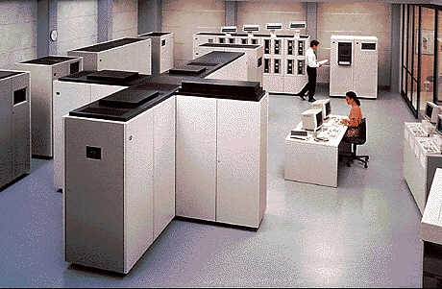
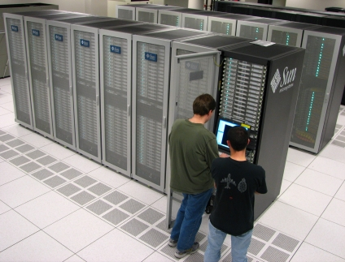

Slide 17
Supercomputers
Used in scientific and engineering applications those handling huge data and do a great amount of computation.
Extremely fast in operation
Fastest, costliest and powerful computer available today
Application involves, weather forecasting, military applications, electronic design etc.

Slide 18
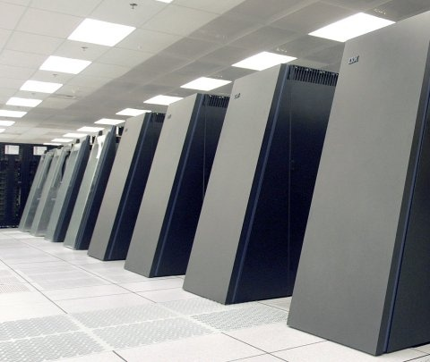
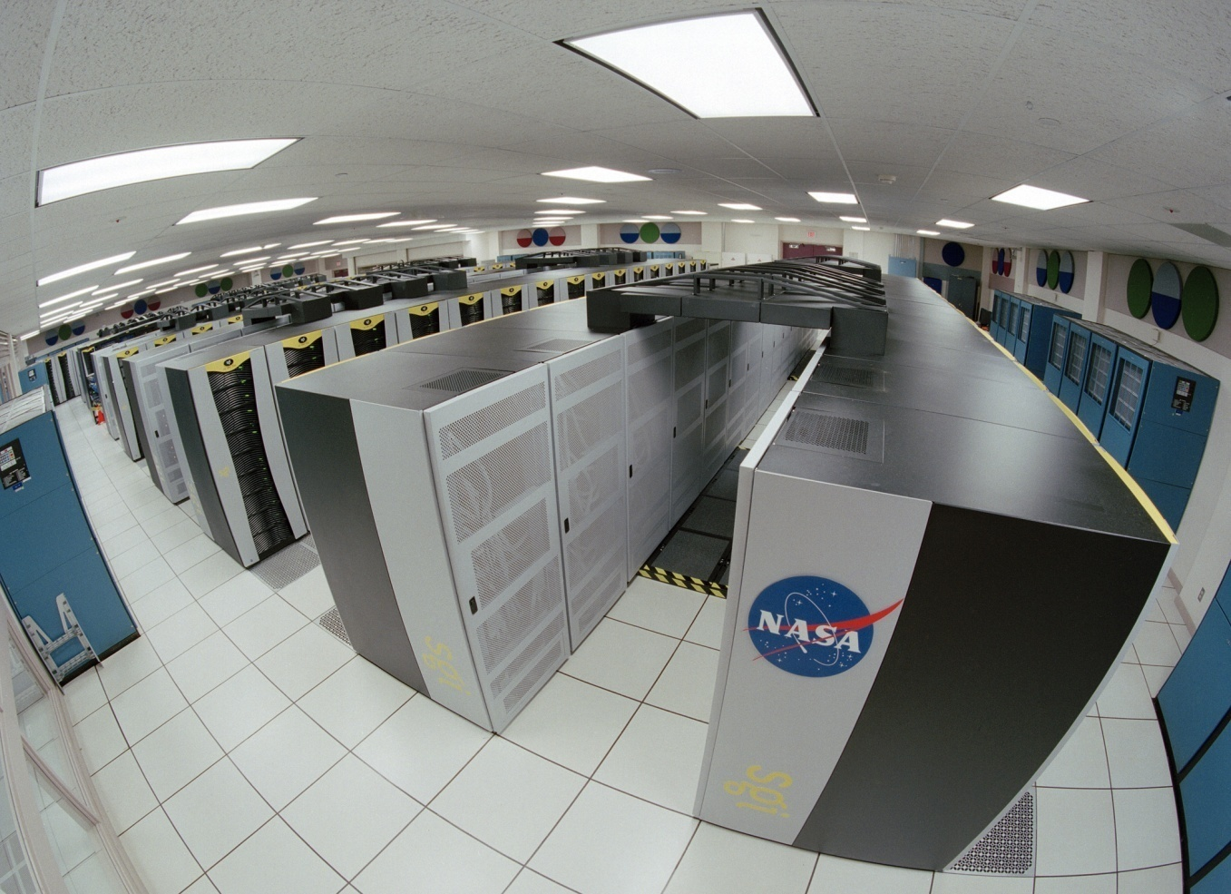

Slide 19
Microprocessor
Microprocessor and CPU are used interchangeably
A microprocessor is a multipurpose, programmable, clock-driven, register based electronic device that reads binary instructions from a storage device called memory, accepts binary data as input and processes data according to those instructions and provides results as output.

Slide 20
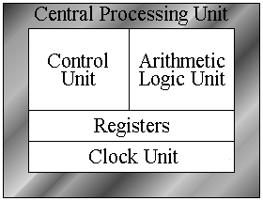
Central Processing Unit(CPU)
It is the part of the computer that actually does the computation. It has three parts-
Control Unit
Arithmetic Logic Unit (ALU)
Registers

Slide 21
Control Unit
The coordination and control of a computer system is the sole responsibility of the control unit.
It interprets the instructions fetched into the computer, determines what data, if any, are needed, where it is stored, where to store the results of the operation.
It ensures that according to the fetched instructions the right operation is done on the right data at the right time.

Slide 22
Arithmetic Logic Unit (ALU)
The arithmetic and logic unit (ALU) is the part where actual computations take place.
It consists of circuits which perform arithmetic operations (e.g. addition, subtraction, multiplication, division) over data received from memory and capable to compare numbers.

Slide 23
Registers
While performing these operations the ALU takes data from the temporary storage area inside the CPU named registers

